Slide 1
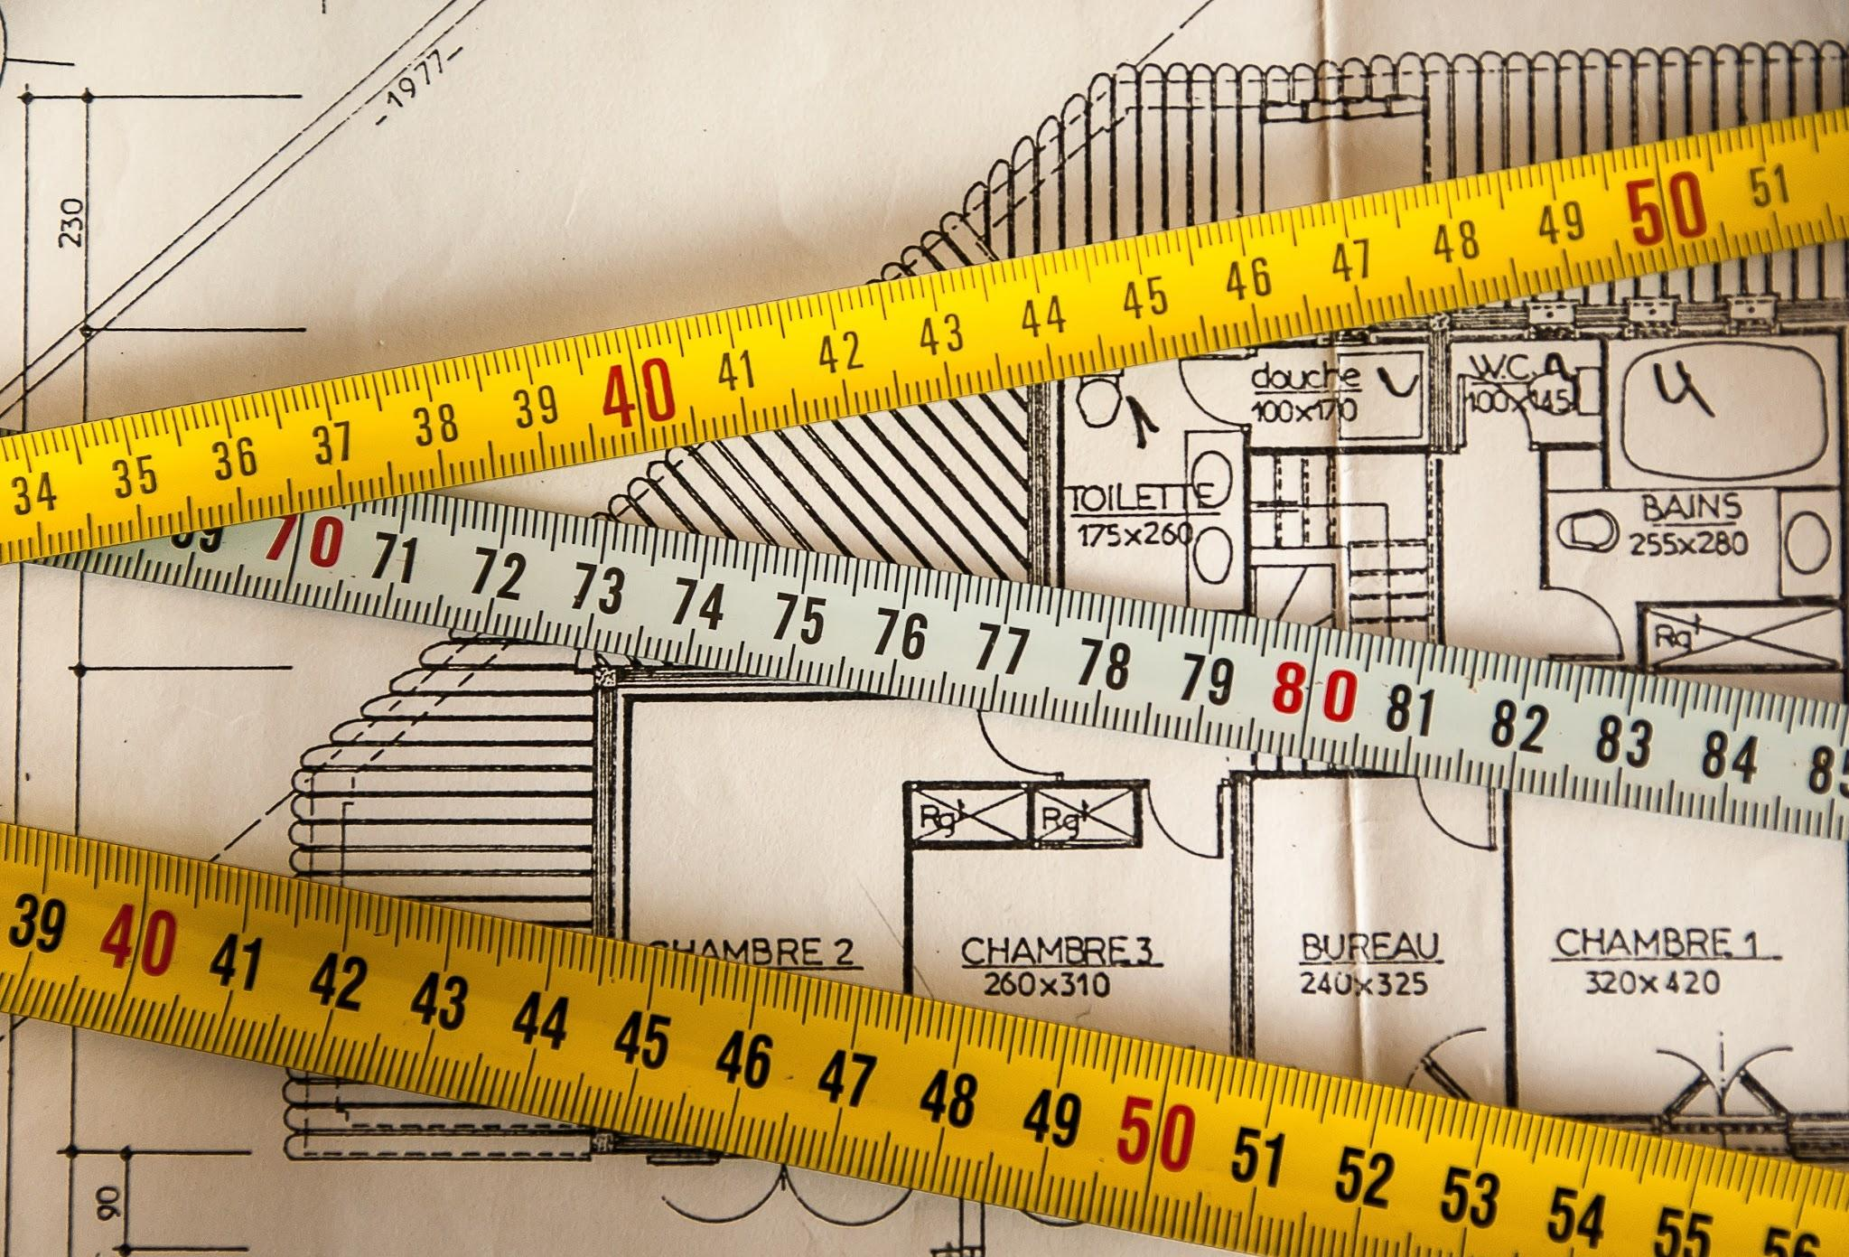
Measuring time!
Thursday- August 30, 2018

Slide 2
Warm-up #3:
An ecologist wants to study the effects of pollution on plant growth. The scientist uses two groups of plants. To the first group, a type of pollutant is added. To the second group, nothing is added. The scientist records plant growth for each plant for two weeks. What is the purpose of the second group in the scientist’s study?

Slide 3
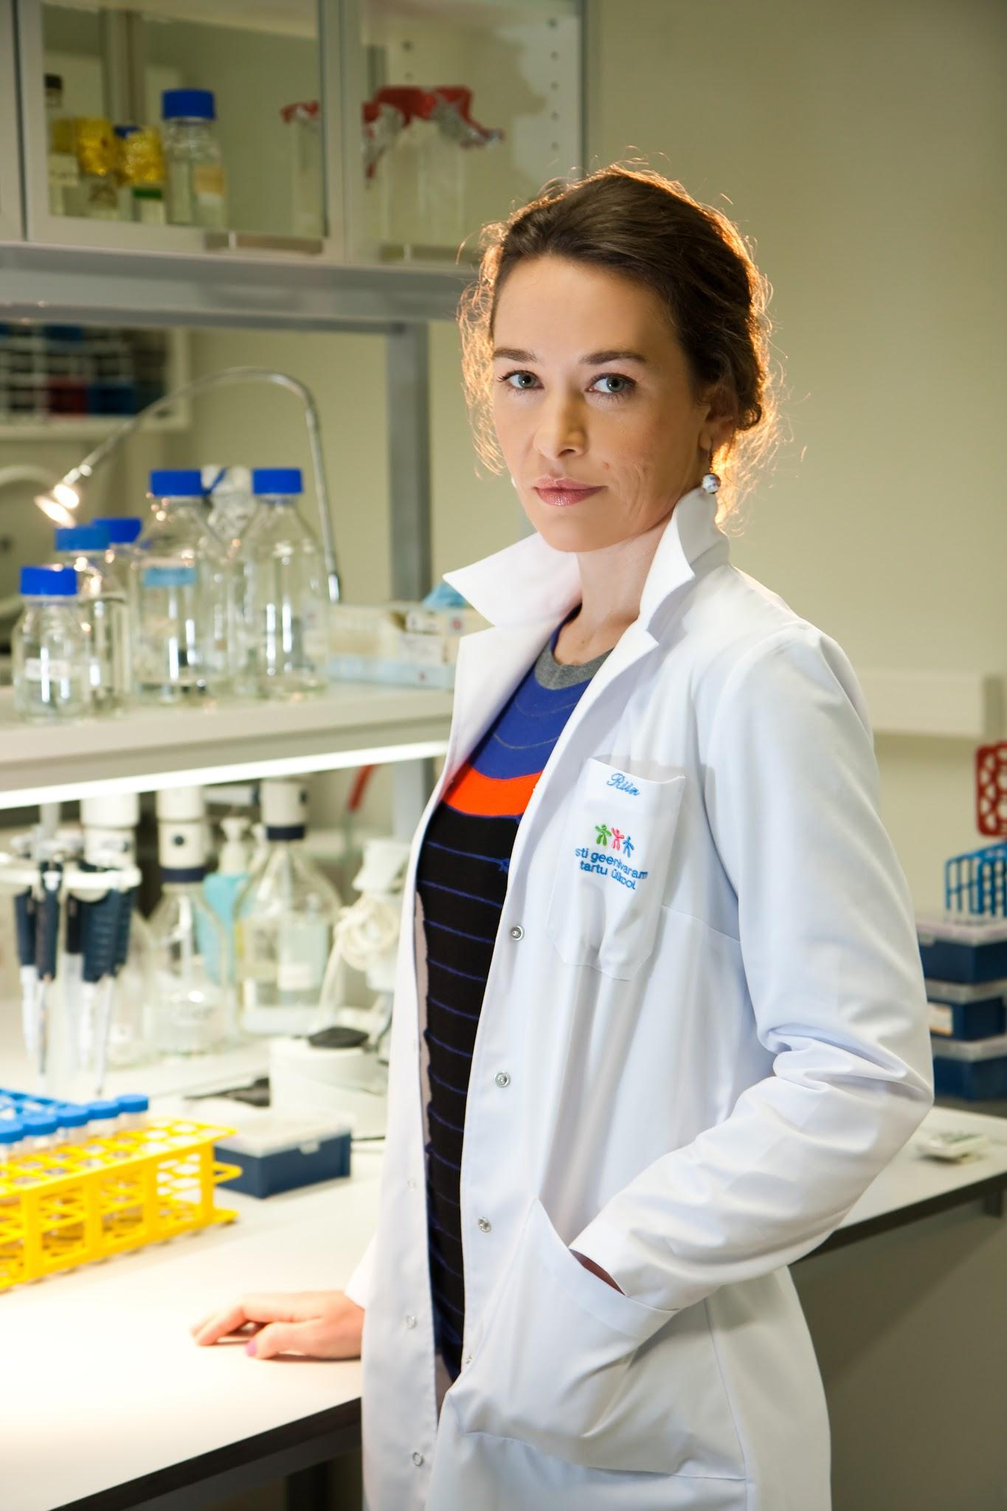
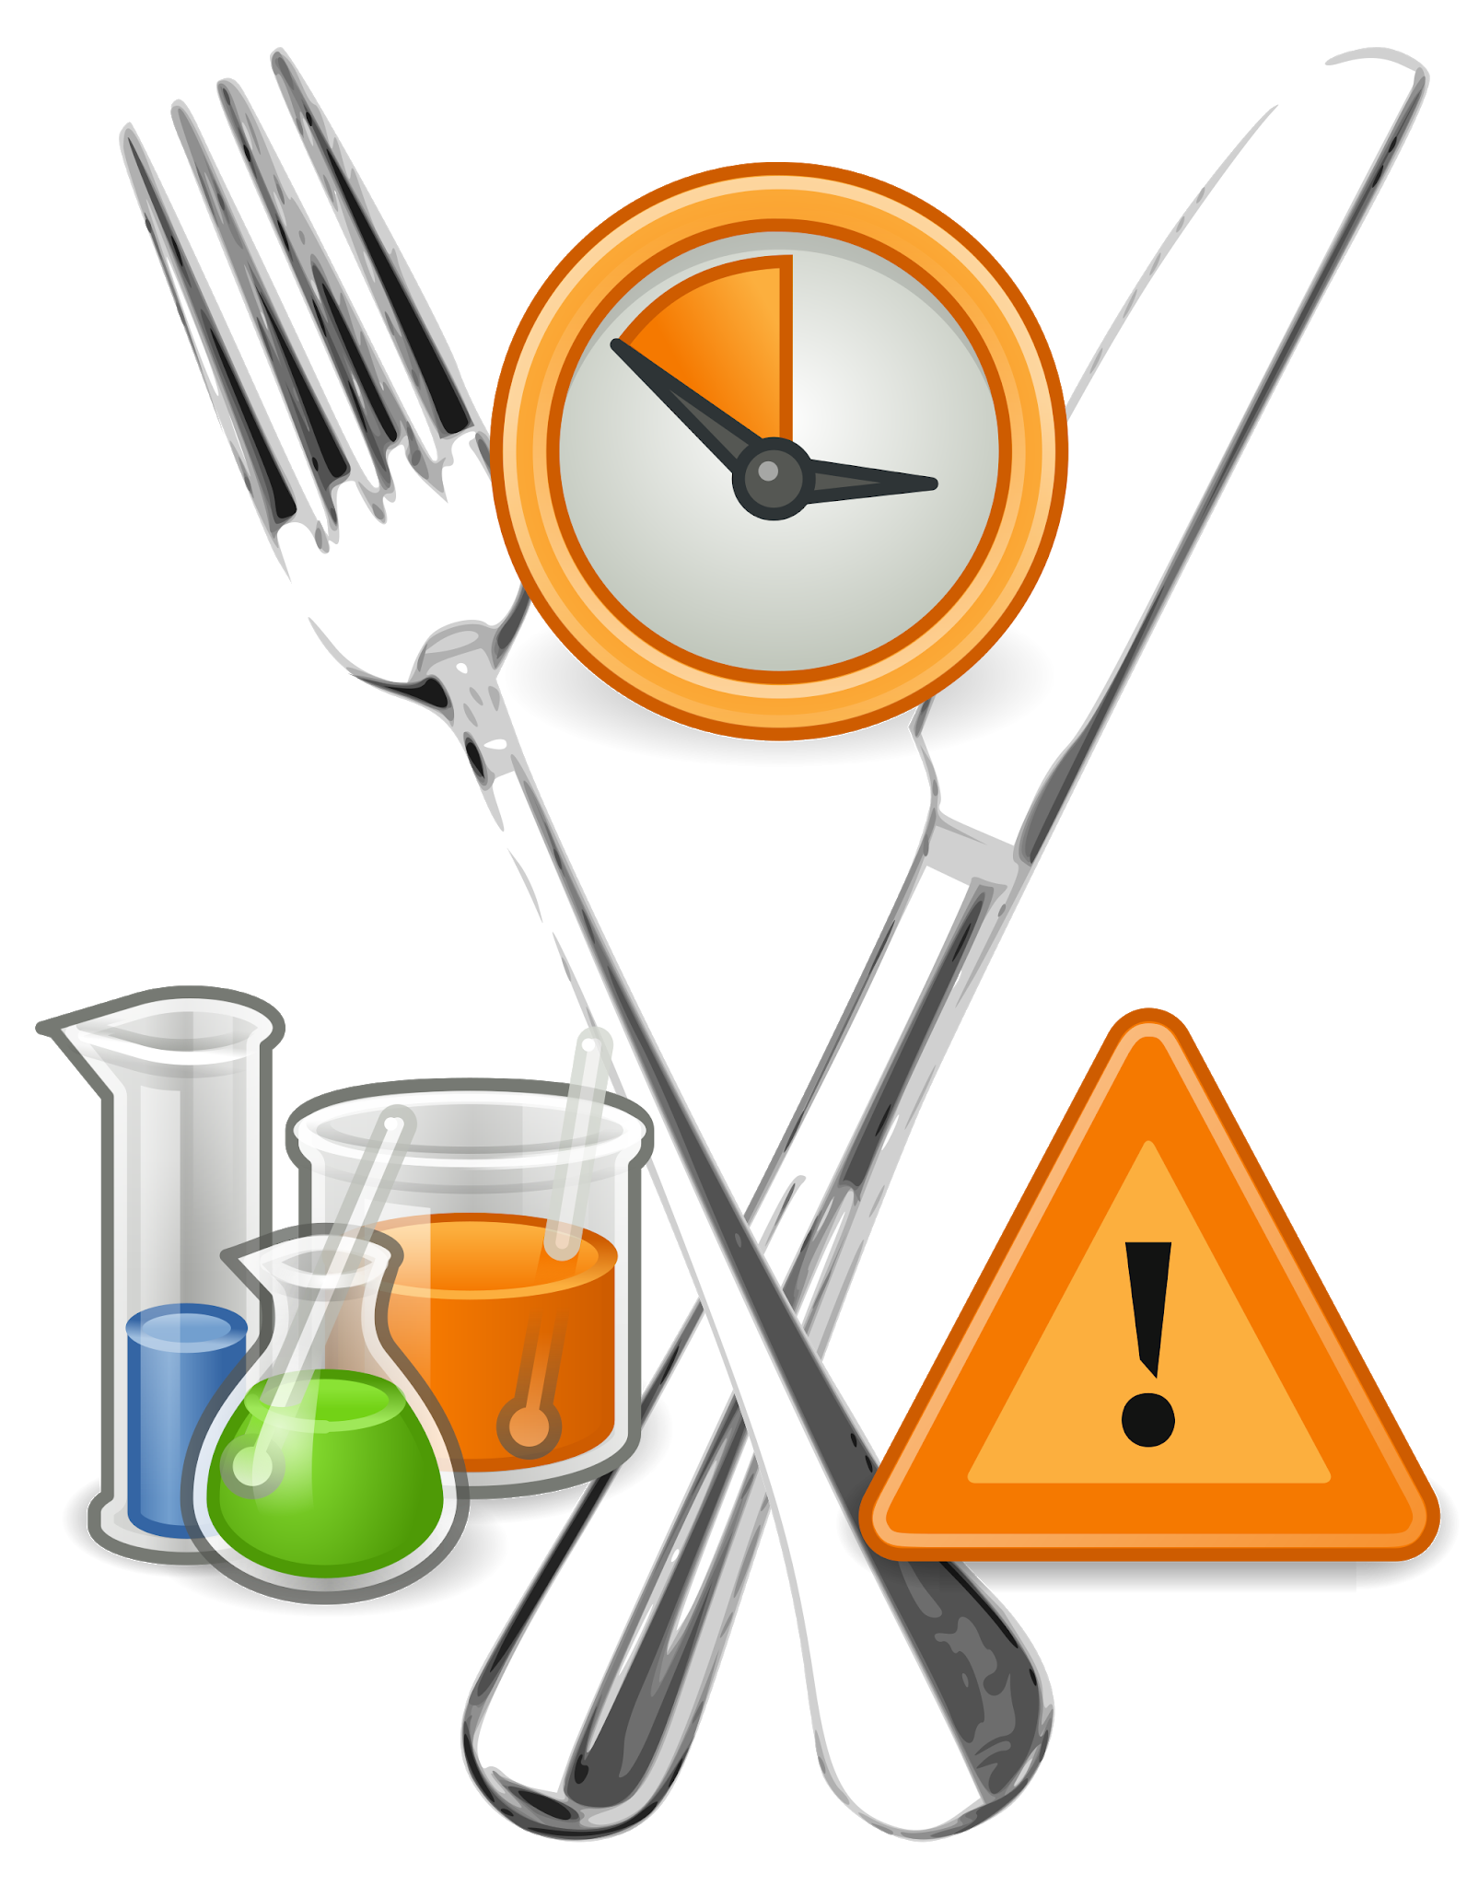
Lab Safety Contract

Slide 4
Question: Do you consider yourself charming?
Which applies to you most?
Charming: Do others often flirt with you, or respond well to your flirtations? It’s probably because your ring finger is longer than your index finger.
You ooze with confidence and charm, so you tend to take more risks — and they often pay off handsomely. Some might say you can be a bit aggressive, but if you know what you want, why not go for it?
If this doesn’t sound like you, it might be time to make some changes in your life, because your fingers say otherwise! Your perfect profession would be soldier, salesperson, or CEO.
2.
3.

Slide 5
Or do you consider yourself a natural leader?
Would you consider yourself a confident, take-charge kind of person? If your index finger is longer than your ring finger, then your answer should be “heck yes!”
You were born to lead the pack. In sticky situations, you’re quick on your toes and eager to guide the way. Resourceful, even-tempered, and confident, people look to you for the right answers.
If you don’t agree with this, then your genes are telling you to reassess yourself, because you’re destined to hold the reins. Your ideal job would be politician, author of self-help books, or teacher.

Slide 6
Or...do you consider yourself a good communicator?
Are people always telling you their deepest secrets, even if you don’t know them very well? It’s probably because your ring finger and index finger are the exact same length.
You’re a balanced person who tends to listen twice and speak once, and people are drawn to that. You make others feel comforted and appreciated when they need it most. You’re peaceful, compassionate, and warm, so you’re at your best when helping others.
If you don’t connect with this description, then it’s time to look inwards and find the balanced, softer side of yourself. Your fingers prove that it’s there. Your ideal profession would be nurse, social worker, or therapist.

Slide 7
Notes on Measurement: Write this down!
Le Systeme International d’Unites → SI (modern version of the metric system)
Uses 10 as the base unit number
Length: meter
Mass: grams, the amount of matter in an object
Weight: Newtons (N), a measure of gravitational force on an object
Area: square meter (m^2)
Volume: cubic meter (m^3)
Density: grams per cubic meter OR g/cm^3
Time: seconds (s), hour (h)
Temperature: Kelvin (K) → always add +273 to a given temperature in celsius.
Notes:
1 meter is approximately the length of the floor to a doorknob.

Slide 8
Notes on Scientific Notation:
A number express as a value between 1 and 10 multiplied by a power of 10.
Ex: 0.00000056879
Ex: 150,000,000
If a decimal is shifted to the LEFT, it will have POSITIVE exponent
If a decimal is shifted to the RIGHT, it will have a NEGATIVE exponent

Slide 9
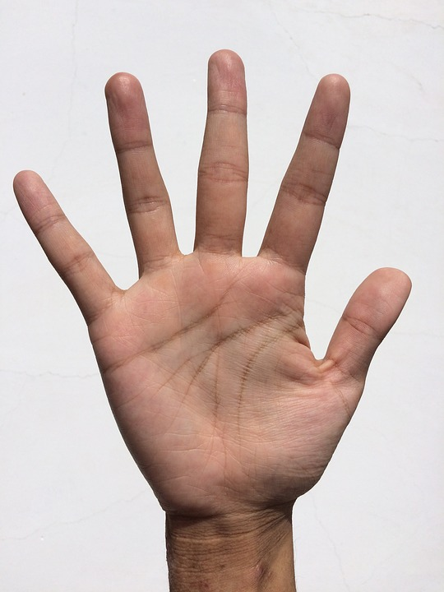
What does finger length have to do with me?

Slide 10
