Slide 1
Warm-up #10:
The Earth is lined up perfectly with the Moon and Sun at the SAME time. What will happen to oceanic tides? Explain your reasoning.
Mr. Skidmore is a brillant astronomer. He looks up in the sky one night and sees a star that is moving around ‘weird.’ How would he scientifically explain this phenomenon and what could he assume from this observation?
Notes:
New planets can be found. Explain the baby leash example

Slide 2
Unit 1 Test grades posted
I still need test grades from: Anna, Chris, and Ashley! You MUST make this up either Thursday or Friday!!!!!!!!!
Quiz 2 on Monday!
Announcements:
Agenda:
Warm-up #10
Electromagnetic Spectrum Model
Notes
Electromagnetic Independent work → group collaboration
Closure: Atmosphere demonstration

Slide 3
The Electromagnetic Spectrum
September 20, 2018 Pg. 764-765

Slide 4
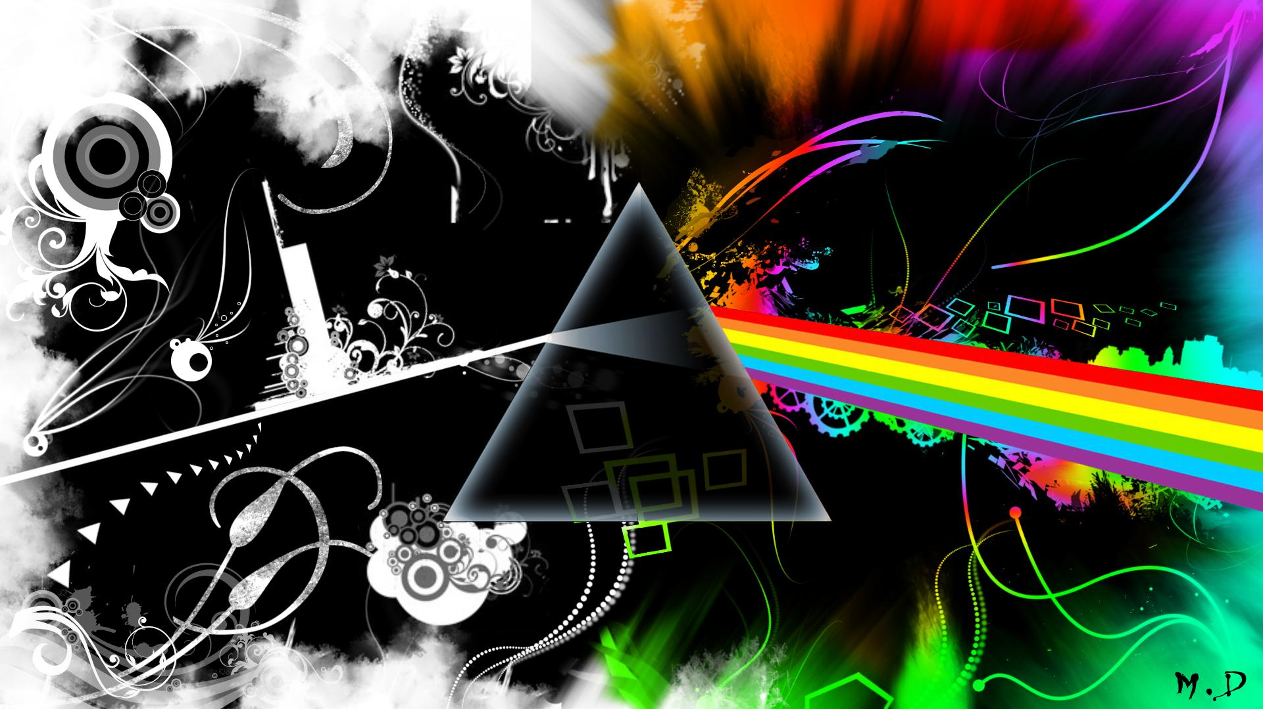
Notes:
Prism
Plant
Tie

Slide 5
What is the electromagnetic radiation?
The radiation (release) from distant bodies throughout the universe
Electric and magnetic disturbances traveling through space as waves.
Disturbances = wave-like motions

Slide 6
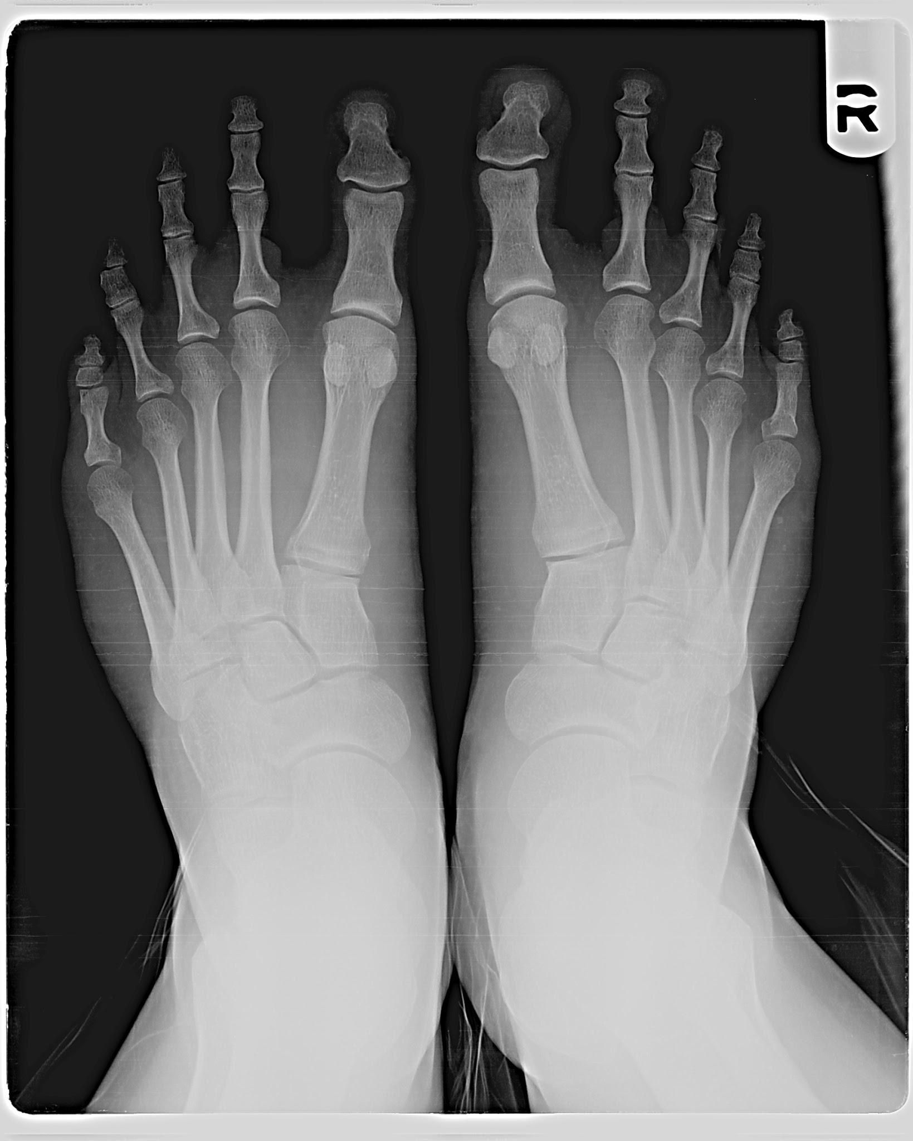
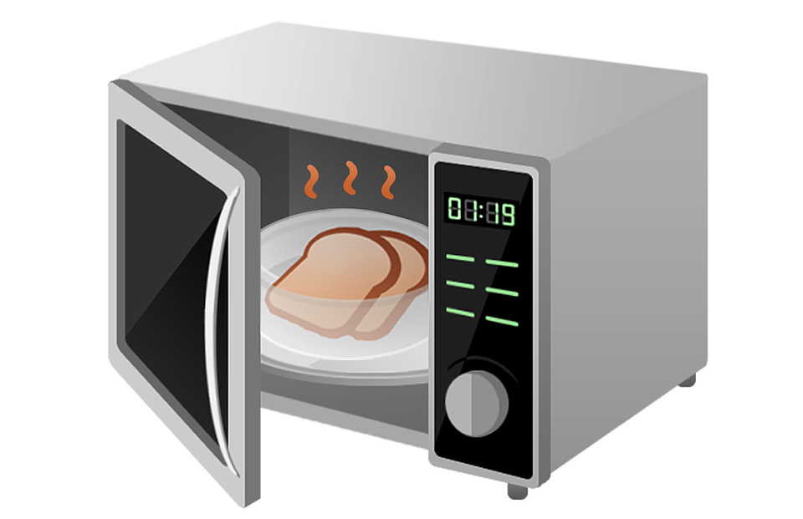
Which forms of electromagnetic radiation are you familiar with?
Overexposure to ultraviolet waves= _______
Microwaves → heat food!
X-rays → provide bone imaging

Slide 7
How do we measure electromagnetic radiation?
Wavelength:
The length of ‘wave’ from period to period
Measured in meters
Frequency:
Measured in cycles per second
Hertz
Similar to ‘tempo’ of music

Slide 8
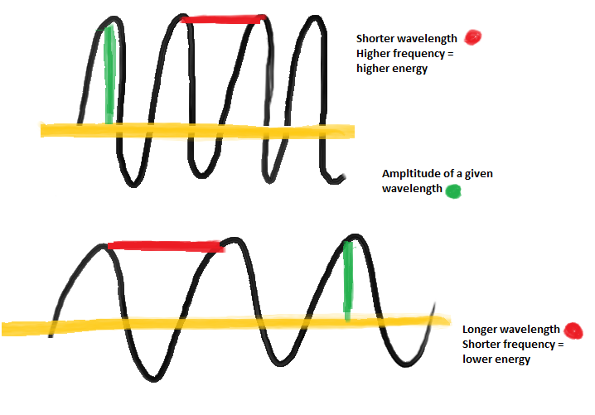

Slide 9
Group roles:
Presenter/Dictator
Researcher
Scribe
Illustrator/Creator

Slide 10
Let’s create the Electromagnetic Spectrum!
Notecard example:
Include the following at a minimum:
Name of selected part of EM spectrum
UNLABELED wave model of designated part of EMS
Illustration related to the selected part (1 minimum)
After research, include the following in your description:
Energy (Low, Medium, High)
Frequency range
Wavelength range
Practical uses (How does it apply to the 21st century?)
Interesting fact(s).
Name for assigned part of EMS: ________________________
Illustration Energy (Low, med., high) Frequency range Wavelength range Practical uses Interesting fact(s)
https://imagine.gsfc.nasa.gov/science/toolbox/emspectrum1.html

Slide 11
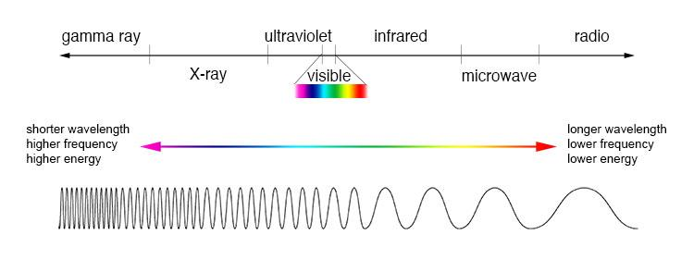
Finished EMS Class Poster:
The goal is to be able to fit each section together to create the ENTIRE Electromagnetic Spectrum
Collaborate with other groups to ensure that your posters fit together!

Slide 12
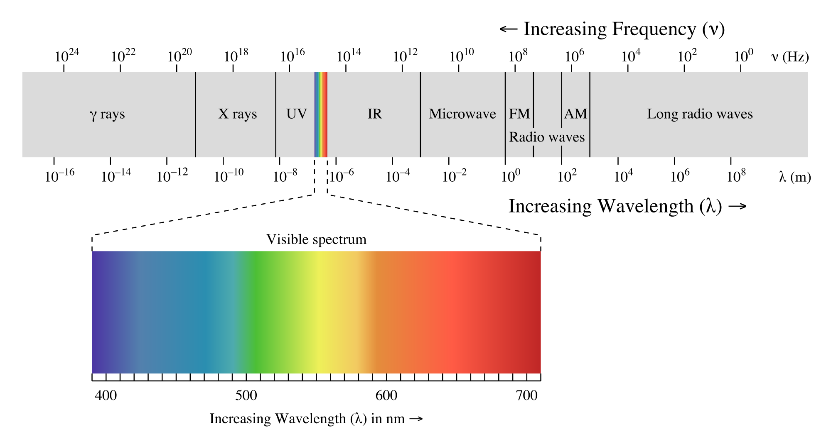
Visible Light Spectrum: The light we can see!
In between UV and IR
ROY G BIV
RED=longest
BLUE=shortest
How do you think this would affect how we see stars?

Slide 13
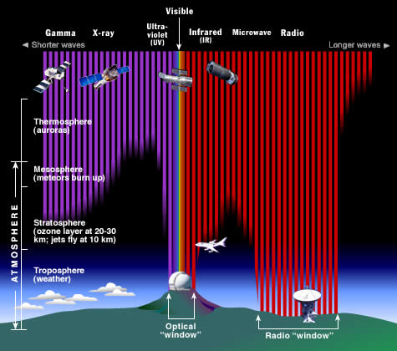
The atmosphere is a protective layer
Only certain electromagnetic waves can reach Earth’s surface!
How does human pollution affect these EM waves?
Closure
https://imagine.gsfc.nasa.gov/science/toolbox/emspectrum1.html
Notes:
The Earth's atmosphere stops most types of electromagnetic radiation from space from reaching Earth's surface. This illustration shows how far into the atmosphere different parts of the EM spectrum can go before being absorbed. Only portions of radio and visible light reach the surface. (Credit: STScI/JHU/NASA)

