Slide 1
Warm-up # 8?
What is the term used for ‘center of mass’ or ‘center of gravity’?
How do astronomers find new planets in space? Explain your reasoning.

Slide 2
Review: Earth’s Motions + Introduction to the Electromagnetic Spectrum
September 18, 2018

Slide 3
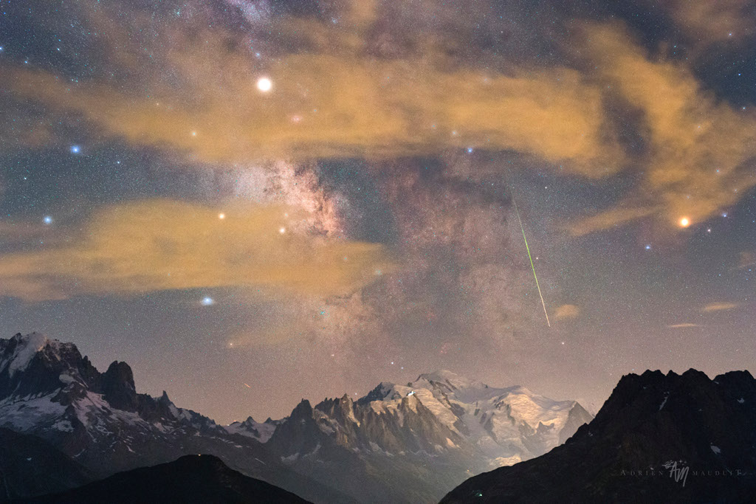
Notes:
Snowy Mont Blanc is near the center of this atmospheric night skyscape. But high, thin clouds fogged the skies at the photographer's location, looking south toward Europe's highest peak from the southern Swiss Alps. Still, the 13 second exposure finds the faint star fields and dark rifts of the Milky Way above the famous white mountain. Bloated by the mist, bright planet Saturn and Antares (right), alpha star of Scorpius, shine through the clouds to flank the galaxy's central bulge. The high-altitude scene is from the rewarding night of August 12/13, so it also includes the green trail of a Perseid meteor shooting along the galactic plane.

Slide 4
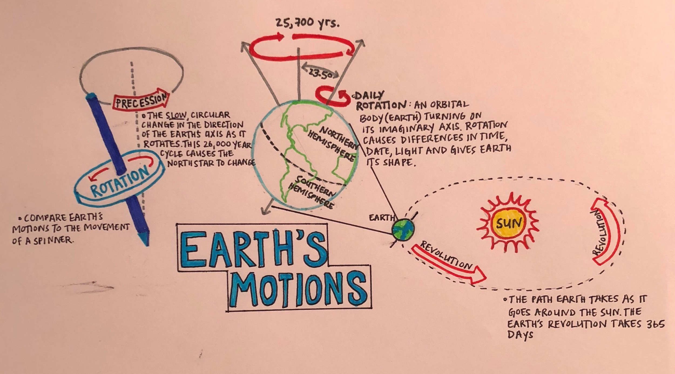

Slide 5
Earth’s Motions Review
Check out my website: www.skidmoreeesak.weebly.com and look under the Astronomy files section.
There you will find a document titled, “Earth’sMotionsWebQuest”
Open this document and follow the directions!
Fill out the worksheet as you go along + I will be collecting this!

Slide 6
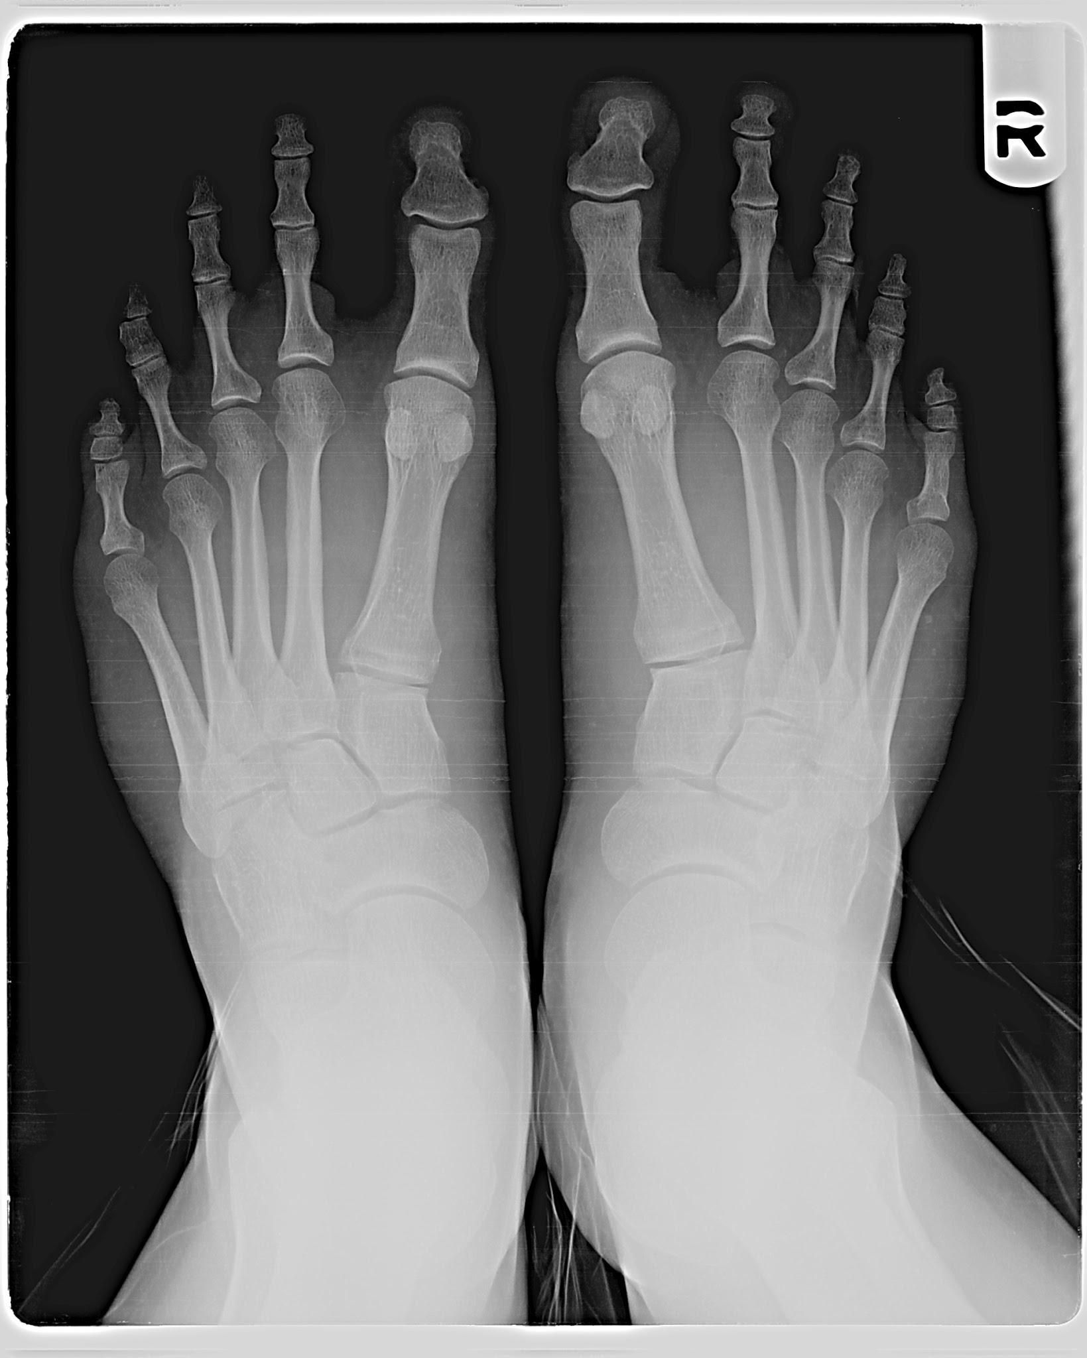
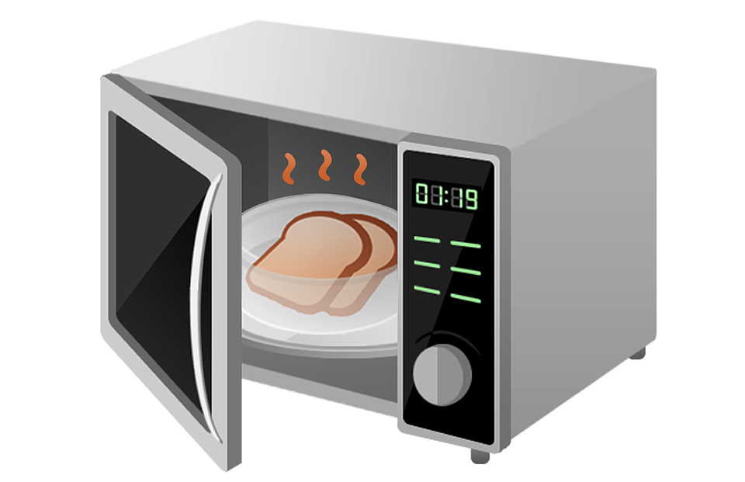
Which forms of electromagnetic radiation are you familiar with?
Overexposure to ultraviolet waves= _______
Microwaves → heat food!
X-rays → provide bone imaging

Slide 7
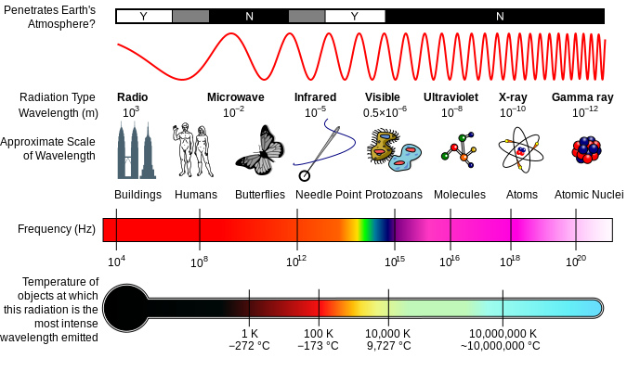
What is the electromagnetic spectrum?
All types of electromagnetic radiation, arranged according to:
Wavelength
Frequency
Radio waves = LONG
Gamma rays = SHORT

Slide 8
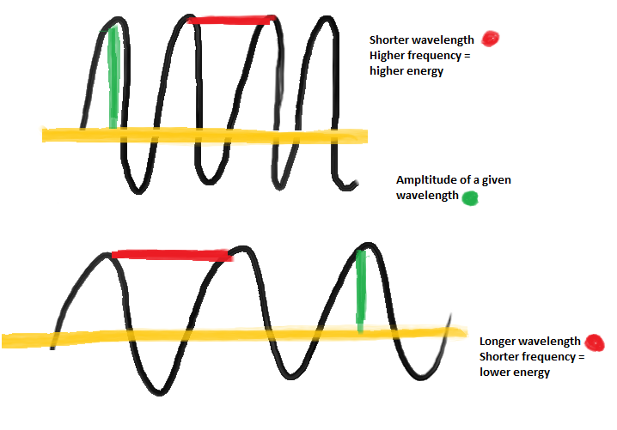

Slide 9
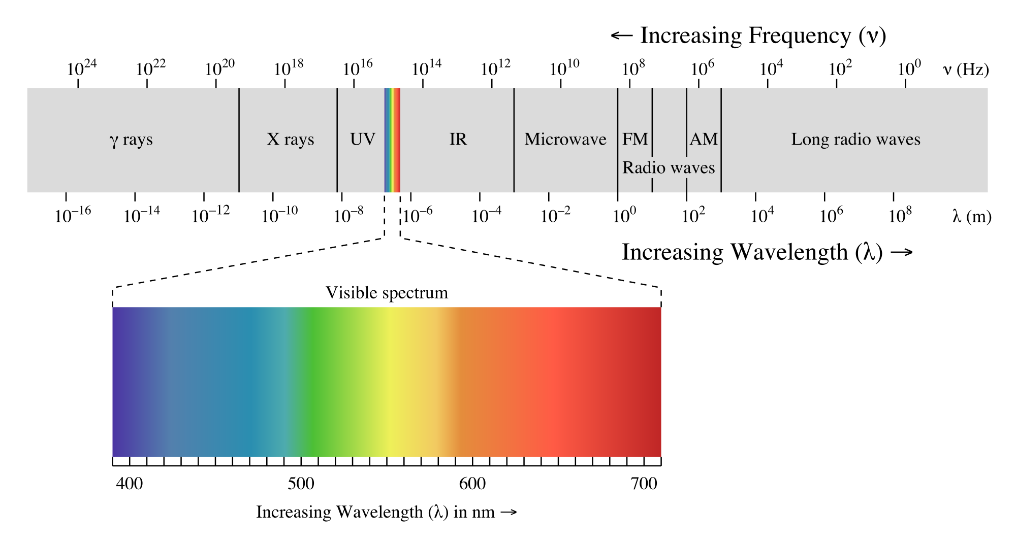
Visible Light Spectrum: The light we can see!
In between UV and IR
ROY G BIV
RED=longest
BLUE=shortest
How do you think this would affect how we see stars?

Slide 10
Closure: Kahoot.It Time!

